Slide 1
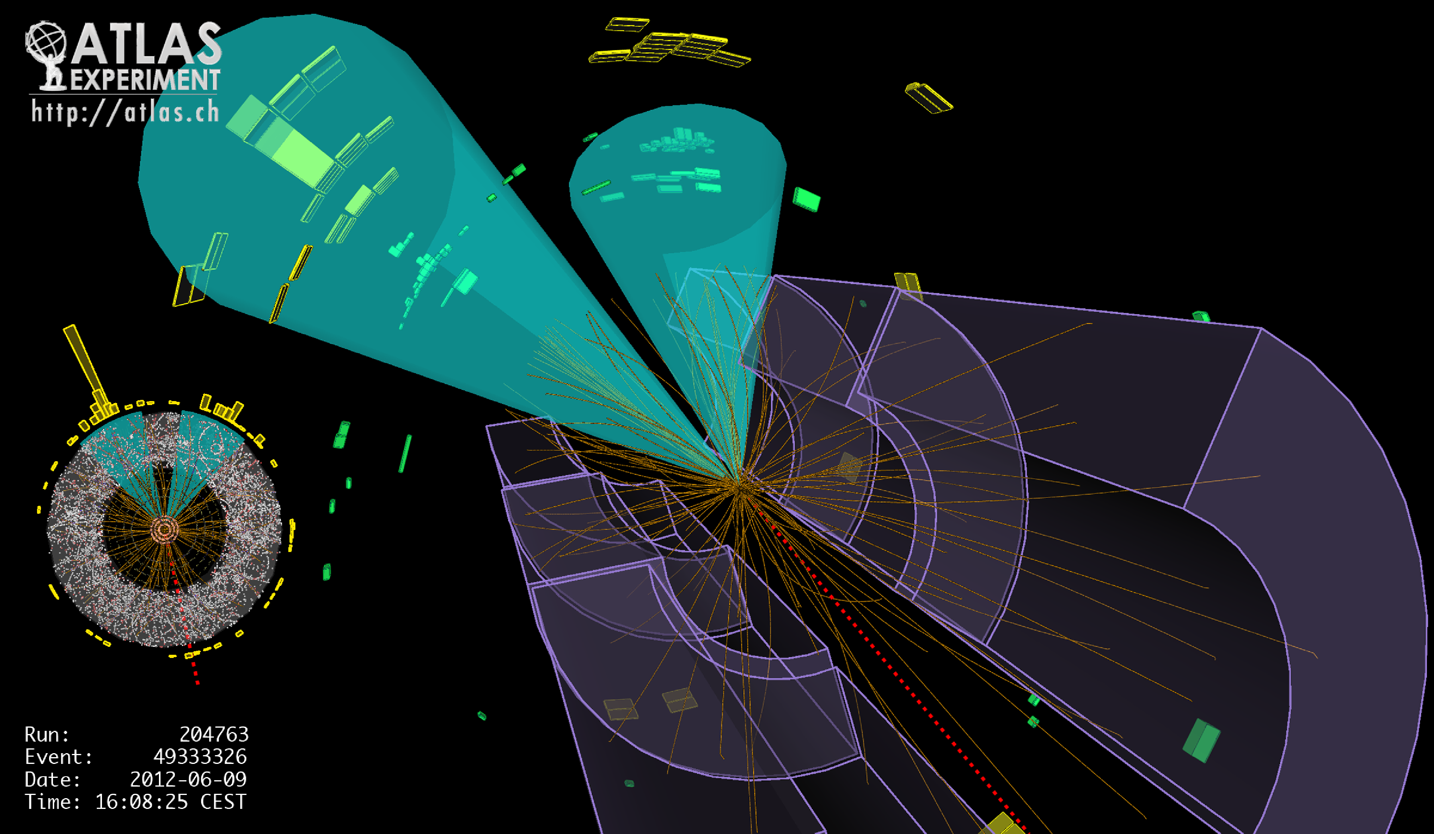
Lecture #14
Prof. Dr. Florencia Canelli
Universität Zürich
Elementary particle physics - PHY451
HS2016

Slide 2
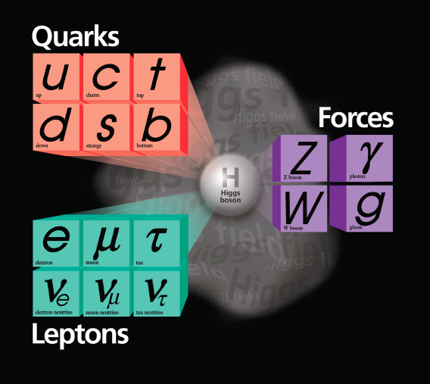
Fundamental Particles and Forces
Matter
is made out of fermions
Forces
are mediated by bosons
Higgs boson
breaks the electroweak symmetry and gives mass to fermions and weak gauge bosons
Amazingly successful in describing precisely
data from all collider experiments

Slide 3
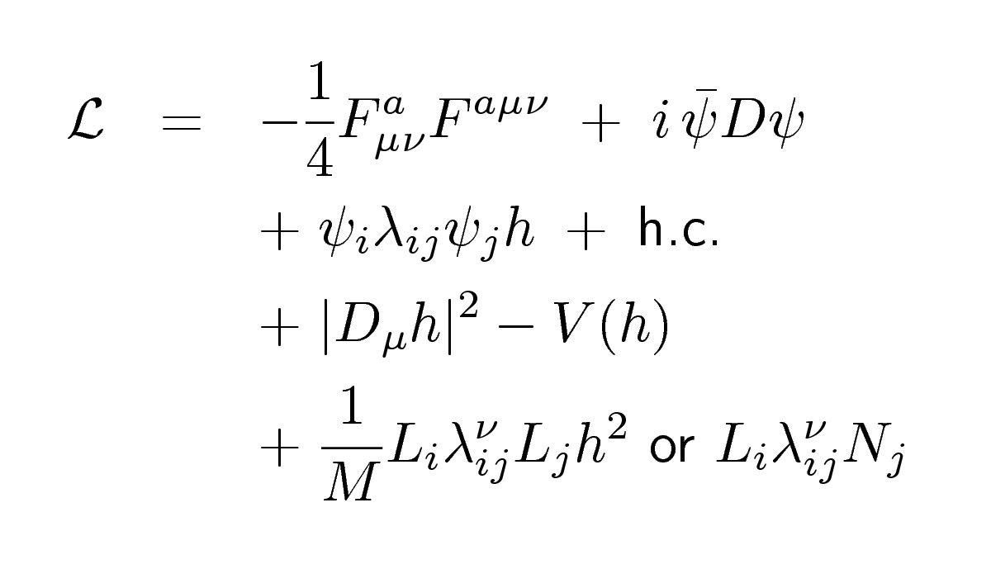
The Standard Model Lagrangian
gauge sector
flavour sector
EWSB sector
ν mass sector
… and beyond?
supersymmetry (many variants)
extra spacetime dimensions
compositeness
strong electroweak symmetry breaking
…
something new?!
[W. J. Stirling]

Slide 4
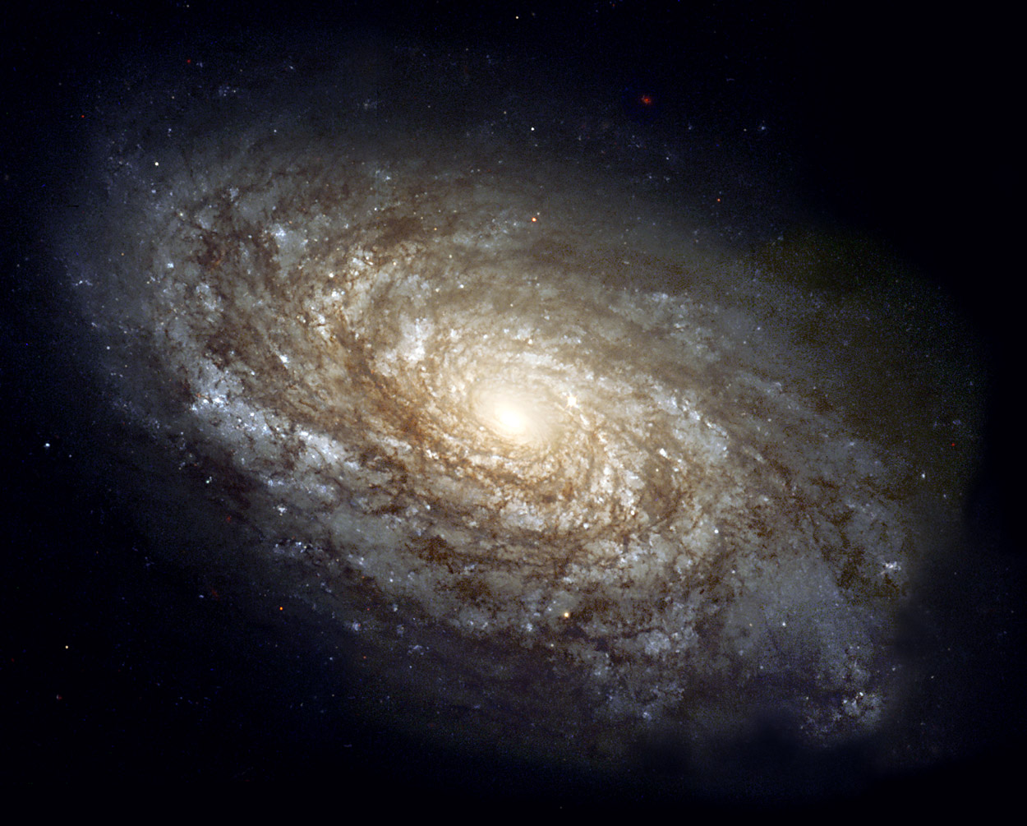
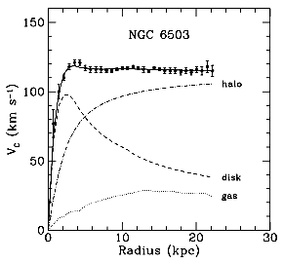
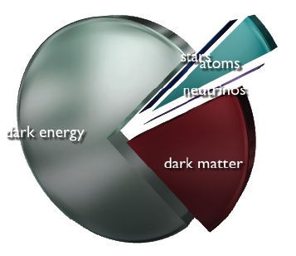
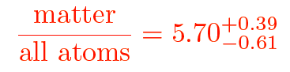
Problem I: What is the Dark Matter?
Standard Model only accounts for
20% of the matter of the Universe

Slide 5
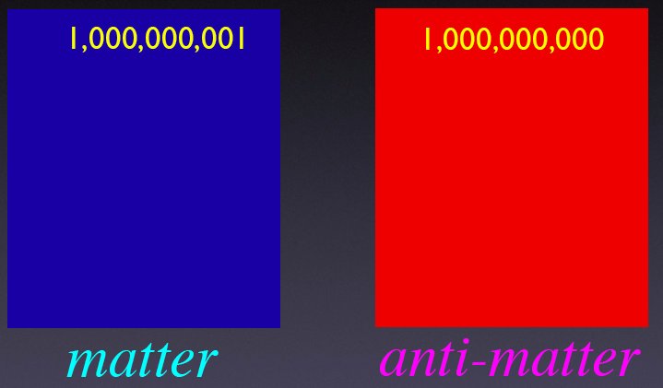
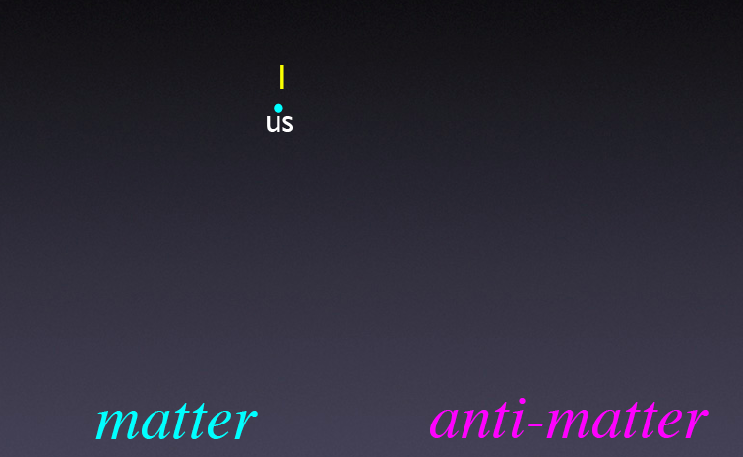
Problem II: Where did all the Antimatter go?
Early Universe
Universe today
Not explained by Standard Model
Need new mechanisms of CP violation

Slide 6
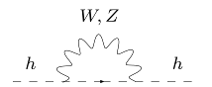
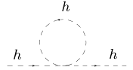
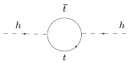
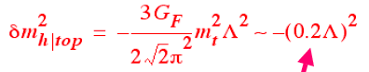
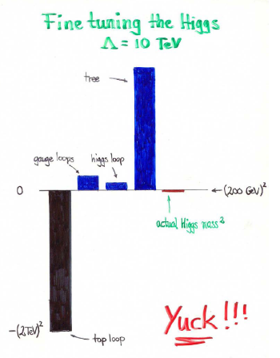
Problem III: Hierarchy Problem
m²_{H} ≈ (125 GeV)² = m²_{H}^{tree} + δm²_{H}^{top} + δm²_{H}^{gauge} + δm²_{H}^{higgs}
Why is the EWK scale so low?
If Λ=M_{Planck} naturally m_{H}=M_{Planck}!
Free parameter m²_{H}^{tree} needs to be “finetuned” to cancel huge corrections
Can be solved by presence of new particles at Λ~1 TeV
Tuning already ~1% for Λ~10 TeV
[M. Schmaltz]

Slide 7
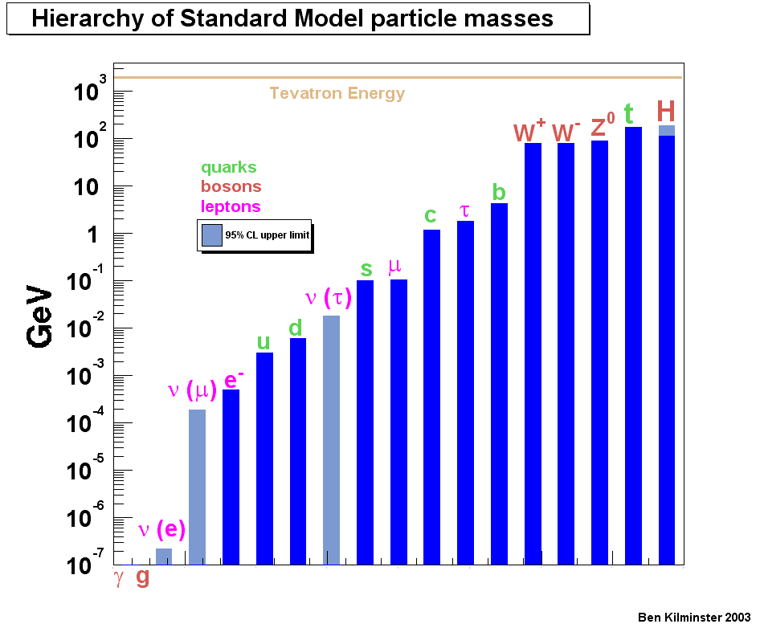
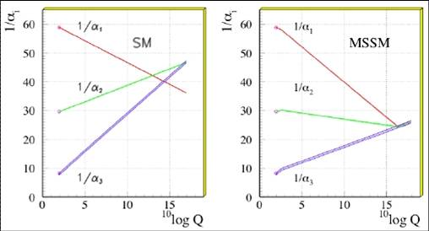
(Some) More Problems …
Matter:
SM cannot explain number of fermion generations
or their large mass hierarchy
m_{top}/m_{up}~100,000
Gauge forces:
electroweak and strong interactions do not unify in SM
SM has no concept of gravity
What is Dark Energy?
“Supersymmetry” (SUSY) can solve
some of these problems
log₁₀ of Energy

Slide 8
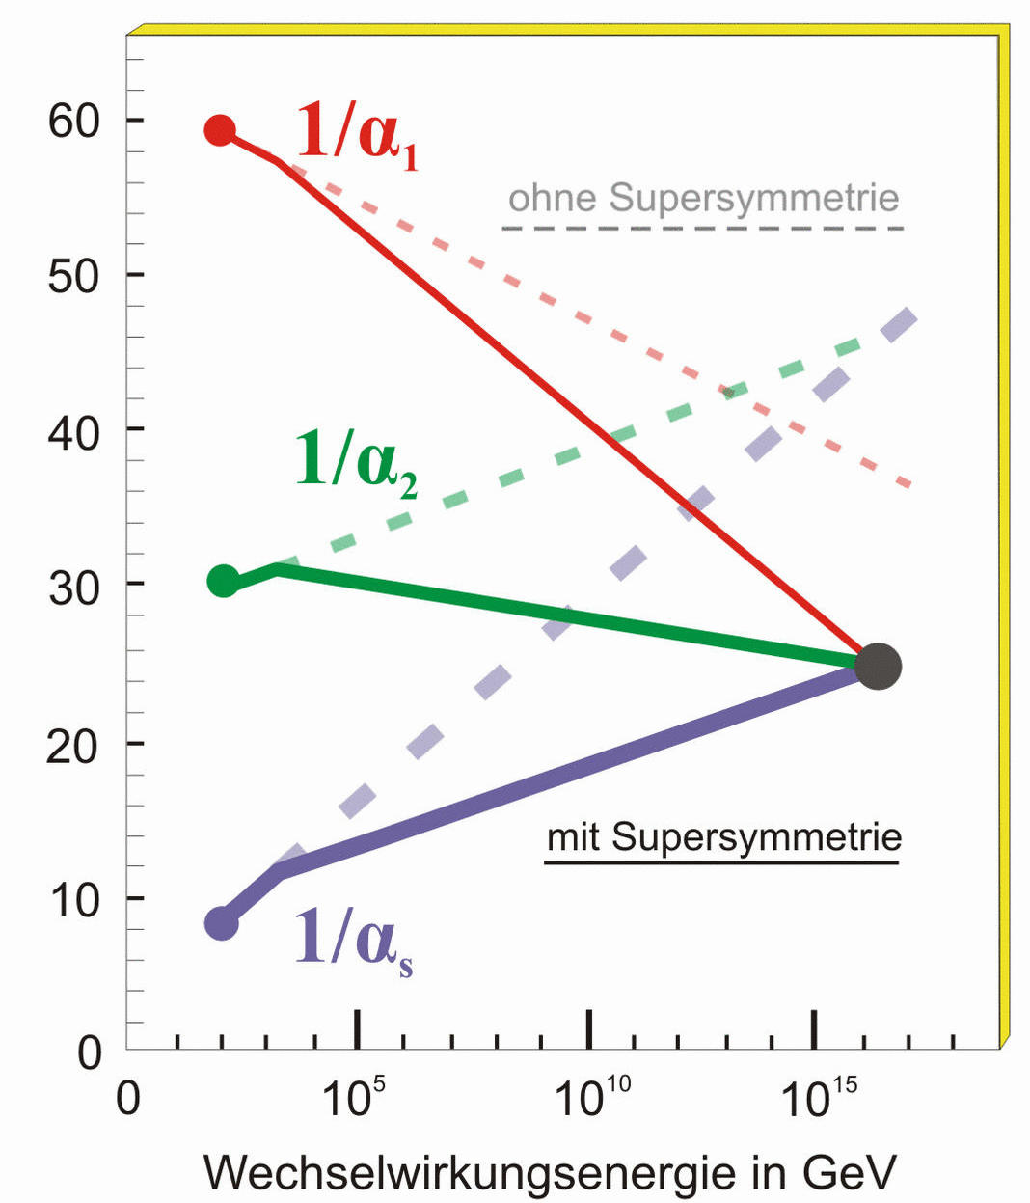
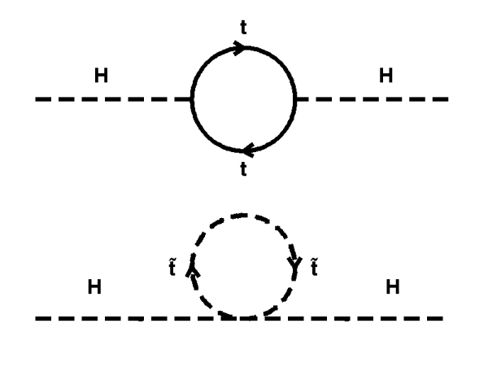
SUSY can solve some problems
Supersymmetry (SUSY)
Each SM particle gets a partner differing in spin by 1/2
Unifications of forces possible
SUSY changes running of couplings
Dark matter candidate exists:
The lightest neutral partner of the gauge bosons
No (or little) fine-tuning required
Radiative corrections to Higgs acquire SUSY corrections
Cancellation of fermion and sfermion loops
Masses must not be too high for this to work (~TeV)
with SUSY
without SUSY
SM
with SUSY
Energy in GeV

Slide 9
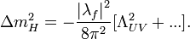
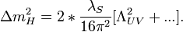
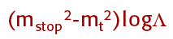
Cancellation of top loop
Remaining problem:
The larger the stop mass the worse the finetuning problem
Need stop mass to be low in SUSY

Slide 10

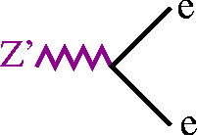

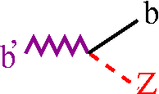

Beyond Supersymmetry
Strong theoretical prejudices for SUSY being true
But so far there is a lack of SUSY observation….
Need to keep an open eye for e.g.:
Extra spatial dimensions:
Addresses hierarchy problem: make gravity strong at TeV scale
Extra gauge groups: Z’, W’
Occur naturally in GUT scale theories
Leptoquarks:
Would combine naturally the quark and lepton sector
New/excited fermions
More generations? Compositeness?
Preons:
atom⇒nucleus ⇒ proton/neutron ⇒ quarks ⇒ preons?
… ????: something nobody has thought of yet

Slide 11
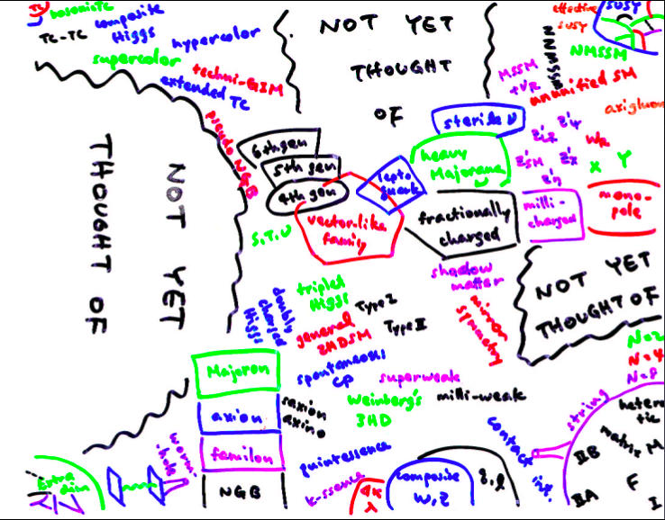
Confusion among Theorists?
[Hitoshi Murayama]
Need experiments to figure out which (if any) represents Nature

Slide 12
Supersymmetry

Slide 13
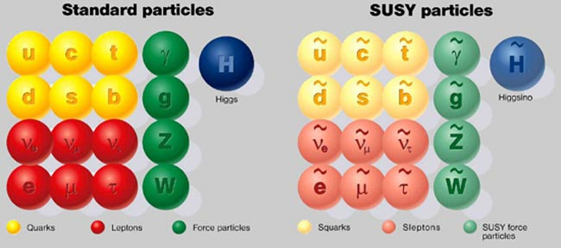
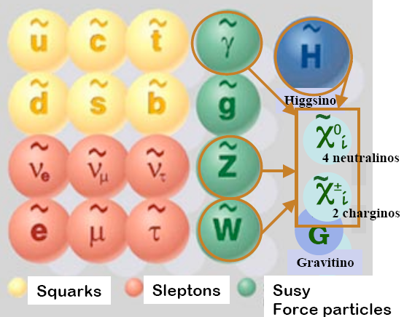
Supersymmetry (SUSY)
γ
G
~
G
SM particles have supersymmetric partners:
Differ by 1/2 unit in spin
Sfermions (squark, selectron, smuon, ...): spin 0
gauginos (chargino, neutralino, gluino,…): spin 1/2

Slide 14
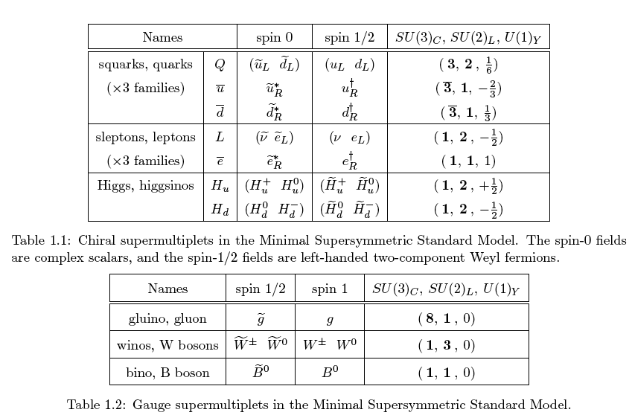
SUSY Particles

Slide 15
SUSY breaking
Since we have not seen selectrons, squarks, etc. it is clear that their masses are much larger than those of SM partners
SUSY must be a broken symmetry
Not clear how the symmetry is broken, many possibilities
Depending on how it is broken the phenomenology changes drastically
Breaking occurs in some “hidden sector” that does not directly (or only very weakly) couple to “visible sector” of MSSM.

Slide 16
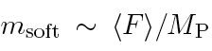
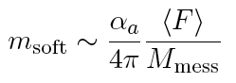
SUSY breaking
Gravity-mediated SUSY breaking:
Breaking by some new particles at scale <F>
where <F> is the VEV of the hidden sector.
For m_{SUSY} ~1 TeV: √<F>~10¹¹ GeV
Gauge-mediated SUSY breaking:
Breaking by some messenger particles
For m_{SUSY} ~1 TeV: √<F>~10⁴ GeV for M_{mess}≈√F
Also called “low-scale SUSY breaking”

Slide 17
R-parity
We can introduce a new quantum number called “R-parity”
It is +1 for all SM particles
It is -1 for all SUSY particles
Requiring that R-parity is conserved implies
SUSY particles can only be produced in pairs (-1)²=+1
SUSY particles always decay into another SUSY particle
The lightest SUSY particle is stable as it cannot decay
This is a good candidate for Dark Matter (“WIMP miracle”)

Slide 18
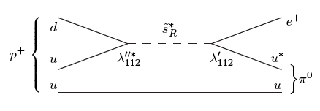
Proton decay
Problem with R-parity violation is proton decay
Proton would decay to e⁺ and pi0
Bounds on proton lifetime: τ >5.8 x 10²⁹ years
From Super-Kamiokande

Slide 19
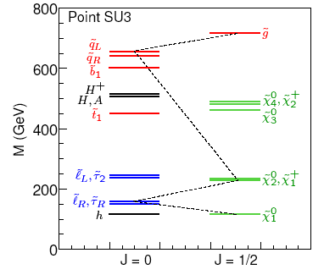
A Typical Sparticle Mass Spectrum
PS: This particular spectrum has been killed by the LHC!

Slide 20
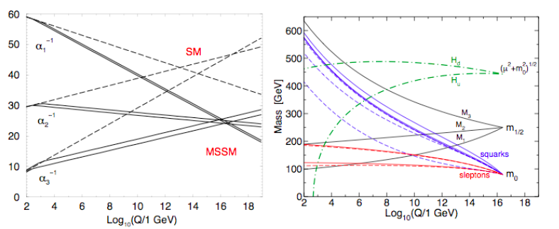
Mass unification?
ewk scale
GUT scale
Common masses at GUT scale: m₀ and m_{1/2}
Evolved via renormalization group equations to lower scales
Weakly coupling particles (sleptons, charginos, neutralions) are lightest

Slide 21
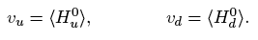
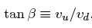
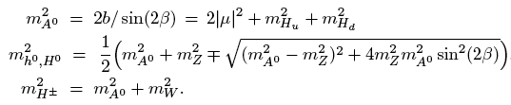
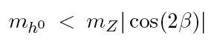
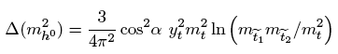
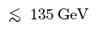
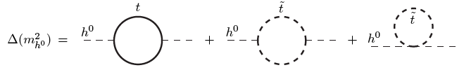
The Higgs in the MSSM
Two Higgs fields
After some math it follows
At tree level one finds
Excluded by LEP since long time!!!
But loop correction lift the Higgs mass
If mSUSY~ 1 TeV

Slide 22
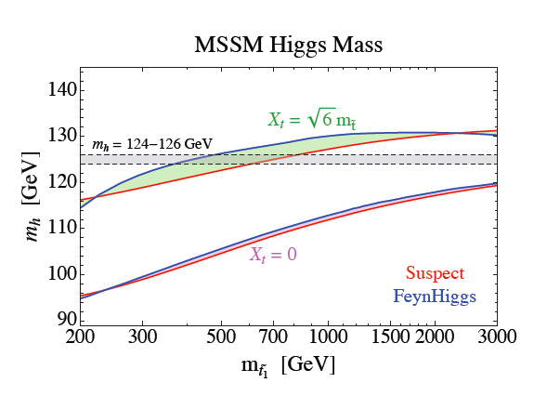
The Higgs in the MSSM
From L. Hall, D. Pinner, J. Ruderman

Slide 23
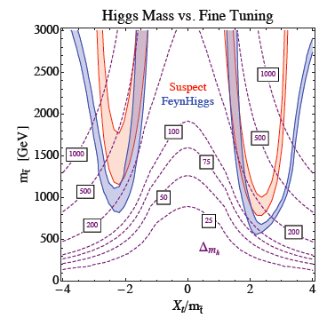
The Higgs in the MSSM
The stop mass needs to be large to lift Higgs mass to 125 GeV
However, as we discussed before we need the stop mass to be low to avoid fine tuning problem
Given m_{H}=126 it is impossible to get small fine tuning without extending MSSM
From L. Hall, D. Pinner, J. Ruderman

Slide 24
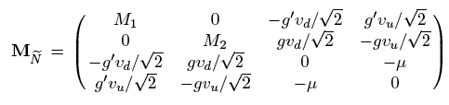
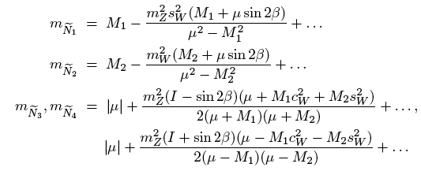
Binos, Winos, Higgsinos mix…
The superpartners of photon, Z, W and Higgs bosons mix
Mass eigenstates are called “neutralions” and “charginos”:
4 neutralinos: N₁..N₄
4 charginos: C±₁, C±₂

Slide 25
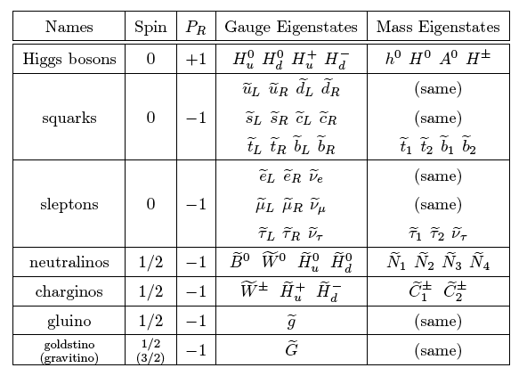
Summary of particles

Slide 26
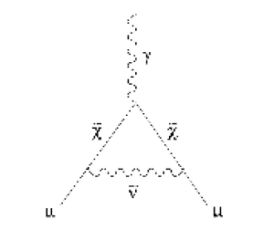
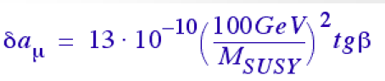
How to find SUSY?
Precision measurements of SM observables
E.g. g-2 for muon
Enhancement in rare decays
E.g. B_{s}->μμ or B⁺->τν
Direct production at colliders
E.g. at LEP or LHC

Slide 27
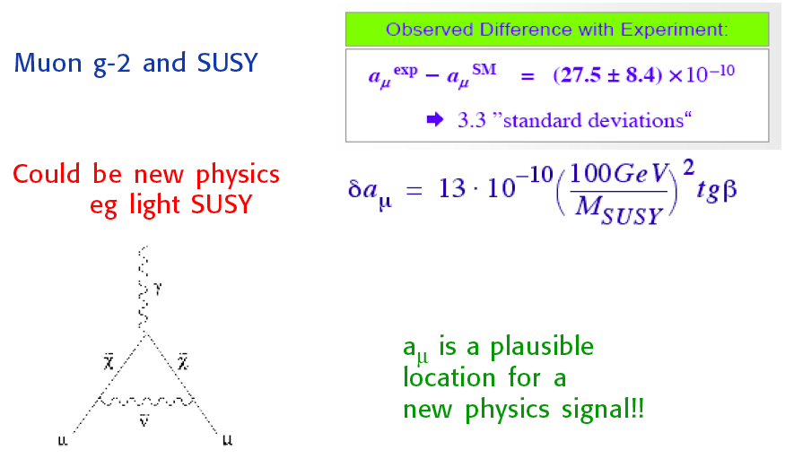
Muons g-2 and SUSY

Slide 28
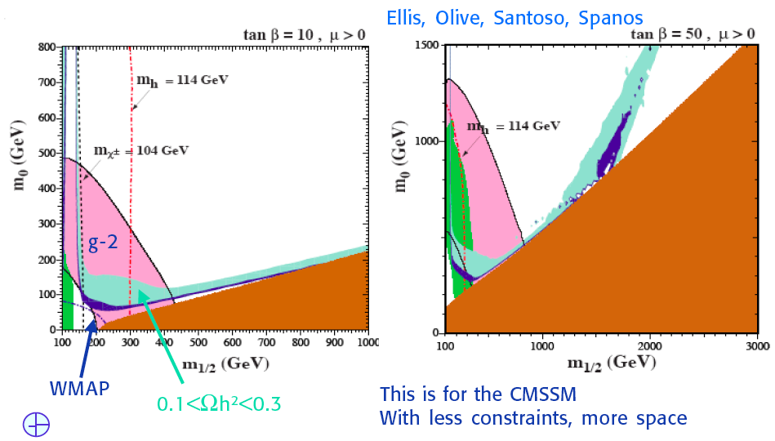
g-2 and SUSY
Simplest interpretation in very constrained models
now ruled out by m_{H}=126 GeV

Slide 29
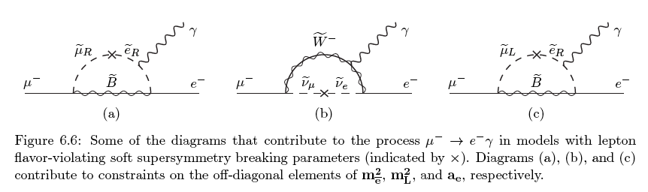
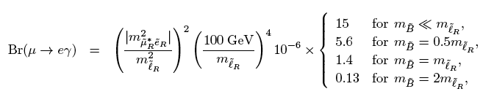

Rare Decays: μ➔eγ
Experimental bound
from MEG at PSI in Switzerland: BR<1.2 x 10⁻¹¹
Mu2e at FNAL plans to improve by factor 10,000

Slide 30



B_{s}→μ⁺μ⁻ branching ratio
Standard Model prediction:
BR=(3.42±0.54) x 10⁻⁹
A.J. Buras Phys.Lett.B 566, 115 (2003)
Large enhancements e.g. in Supersymmetry possible
~ tan⁶β/m_{A}⁴
hep-ph/0603106
Long history of searches
b → sγ allowed
Br(B_{s} → μμ)
excluded

Slide 31


Observation of Bs➔μμ at LHCb
Nov. 2012
Signal observed!

Slide 32


Sparticle cross sections
LHC
100,000 events per fb⁻¹
Tevatron
Cross Section (pb)
100 events per fb⁻¹
T. Plehn, PROSPINO

Slide 33
Strategy for SUSY searches
Minimal Supersymmetric Standard Model (MSSM) has 105 parameters
Impossible to scan full parameter space
Many constraints already from
Precision electroweak data
Lepton flavor violation
Baryon number violation
…
Makes no sense to choose random set
Use simplified well motivated “benchmark” models
Ease comparison between experiments
Try to make interpretation model independent
E.g. not as function of GUT scale SUSY particle masses but versus EWK scale SUSY particle masses
Limits can be useful for other models

Slide 34

SUSY theory phase space

Slide 35
Searches with missing E_{T}

Slide 36


Production and decay
Many production modes
Decay of particles depends on relative couplings
Searches with N jets, E_{T}^{miss} and with and w/o leptons

Slide 37

Example of search result

Slide 38

Limits on Squark and Gluino masses
Gluino mass > 1.0-1.5 TeV
Only applies if all squark masses approximately degenerate

Slide 39

Stop search
Many experimental topologies explored
Still lots of room for stop to be light

Slide 40

Summary of SUSY searches

Slide 41
So… where is SUSY?
HUGE effort has been devoted to
Theorists: understanding advantages of SUSY and phenomenology of it (still ongoing particularly in light of recent Higgs discovery)
Experimentalists: searching for it and interpreting the data in certain scenarios
Despite all this there is no sign of SUSY at all so far but it is still early days: next 5 years very exciting!!!!
If no SUSY is found after ~10 fb⁻¹ of LHC data at 13 TeV this probably kills “natural SUSY”
Dark Matter direct detection experiment are probing most interesting terrain in the next 3 years
Even if no evidence is found in next 5 years SUSY will stay alive as it is just too beautiful and it could just be at much higher scale…

